Slide 1

CSE 604 Artificial Intelligence
Chapter 3: Solving Problems by Searching
Dr. Ahmedul Kabir
Adapted from slides available in Russell & Norvig’s textbook webpage

Slide 2
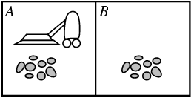
Remember the Vacuum-cleaner world?
Percepts: location and contents, e.g., [A, Dirty]
Actions: Left, Right, Suck

Slide 3
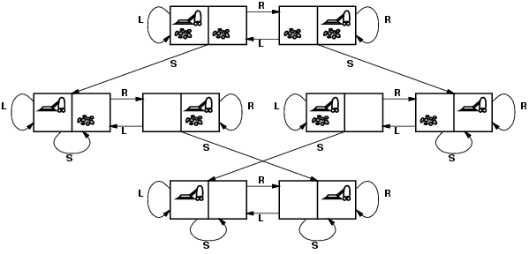
Vacuum world state space graph
State space: Set of all reachable states. In state space graph, nodes/vertices = states, links/edges = actions

Slide 4
Formulation of a Problem
A Problem is defined by the following items:
Set of states the agent can be in, with a designated initial state
Set of actions available to the agent
Transition model describing what each action does (maps a <state, action> pair to a state)
Goal test which determines if a given state is a goal state
A path cost function that assigns a numeric cost to each path

Slide 5
Vacuum world state space graph
states? binary dirt and robot location. Any state can be initial state
actions? Left, Right, Suck
Transition model? As seen in the state space graph
goal test? no dirt at all locations
path cost? 1 per action

Slide 6
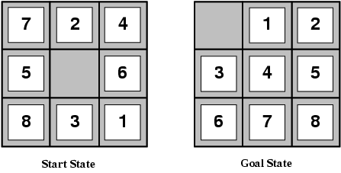
Example: The 8-puzzle
states?
actions?
goal test?
path cost?

Slide 7
Example: The 8-puzzle
states? locations of tiles
actions? move blank left, right, up, down
goal test? = goal state (given)
path cost? 1 per move

Slide 8
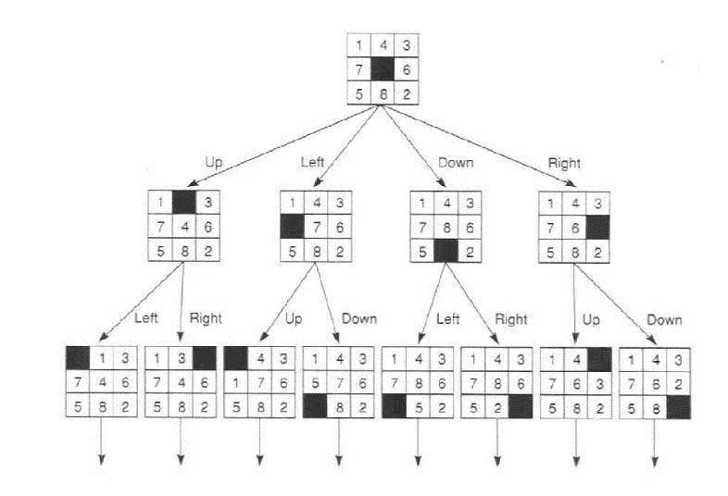
Example: The 8-puzzle
Partial state space graph

Slide 9
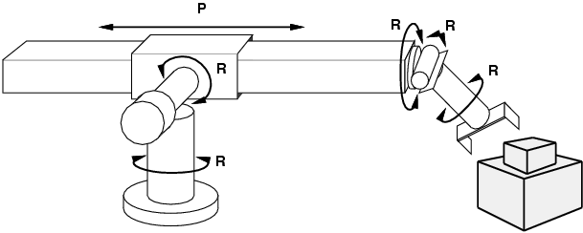
Example: robotic assembly
states?: real-valued coordinates of robot joint angles parts of the object to be assembled
actions?: continuous motions of robot joints
goal test?: complete assembly
path cost?: time to execute

Slide 10
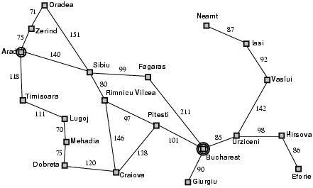
Example: Romania

Slide 11
Search strategies
A search strategy is defined by picking the order of node expansion
Strategies are evaluated along the following dimensions:
completeness: does it always find a solution if one exists?
time complexity: number of nodes generated
space complexity: maximum number of nodes in memory
optimality: does it always find a least-cost solution?
Time and space complexity are measured in terms of
b: maximum branching factor of the search tree
d: depth of the least-cost solution
m: maximum depth of the state space (may be ∞)

Slide 12
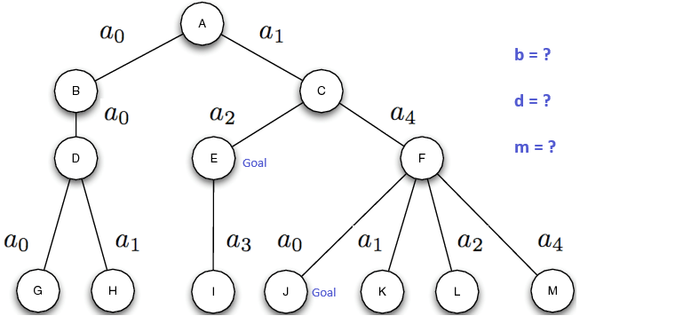
Find b, d, m for this tree

Slide 13
Uninformed search strategies
Uninformed search strategies use only the information available in the problem definition
Breadth-first search
Uniform-cost search
Depth-first search
Depth-limited search
Iterative deepening search

Slide 14
Basic concept
Frontier (or fringe): The set of all leaf nodes available for expansion at any given point
The basics of each algorithm:
Start from initial node
Expand adjacent nodes and put them in the frontier
Choose the next node from the frontier for expansion
Repeat until goal is found, or some ending criteria is met
The algorithms differ in the way they choose the next node from the frontier

Slide 15
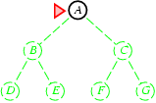
Breadth-first search
Expand shallowest unexpanded node
Implementation:
frontier is a FIFO queue, i.e., new successors go at end

Slide 16
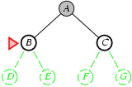
Breadth-first search
Expand shallowest unexpanded node
Implementation:
frontier is a FIFO queue, i.e., new successors go at end

Slide 17
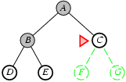
Breadth-first search
Expand shallowest unexpanded node
Implementation:
frontier is a FIFO queue, i.e., new successors go at end

Slide 18
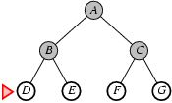
Breadth-first search
Expand shallowest unexpanded node
Implementation:
frontier is a FIFO queue, i.e., new successors go at end

Slide 19
Properties of breadth-first search
Complete? Yes (if b is finite)
Time? 1+b+b²+b³+… +b^{d} = O(b^{d})
Space? O(b^{d}) (keeps every node in memory)
Optimal? Yes (if cost = 1 per step)
Space is the bigger problem (more than time)

Slide 20
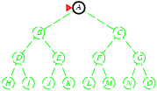
Depth-first search
Expand deepest unexpanded node
Implementation:
frontier = LIFO stack, i.e., put successors at front

Slide 21
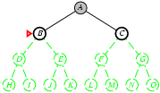
Depth-first search
Expand deepest unexpanded node
Implementation:
frontier = LIFO stack, i.e., put successors at front

Slide 22
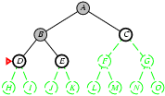
Depth-first search
Expand deepest unexpanded node
Implementation:
frontier = LIFO stack, i.e., put successors at front

Slide 23
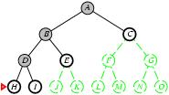
Depth-first search
Expand deepest unexpanded node
Implementation:
frontier = LIFO stack, i.e., put successors at front

Slide 24
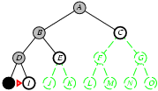
Depth-first search
Expand deepest unexpanded node
Implementation:
frontier = LIFO stack, i.e., put successors at front

Slide 25
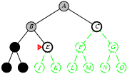
Depth-first search
Expand deepest unexpanded node
Implementation:
frontier = LIFO stack, i.e., put successors at front

Slide 26
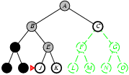
Depth-first search
Expand deepest unexpanded node
Implementation:
frontier = LIFO stack, i.e., put successors at front

Slide 27
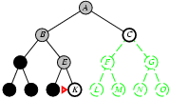
Depth-first search
Expand deepest unexpanded node
Implementation:
frontier = LIFO stack, i.e., put successors at front

Slide 28
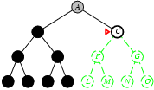
Depth-first search
Expand deepest unexpanded node
Implementation:
frontier = LIFO stack, i.e., put successors at front

Slide 29
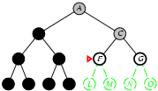
Depth-first search
Expand deepest unexpanded node
Implementation:
frontier = LIFO stack, i.e., put successors at front

Slide 30
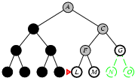
Depth-first search
Expand deepest unexpanded node
Implementation:
frontier = LIFO stack, i.e., put successors at front

Slide 31
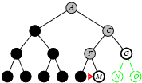
Depth-first search
Expand deepest unexpanded node
Implementation:
frontier = LIFO stack, i.e., put successors at front

Slide 32
Properties of depth-first search
Complete? No: fails in infinite-depth spaces, spaces with loops
Modify to avoid repeated states along path
→ complete in finite spaces
Time? O(b^{m}): terrible if m is much larger than d
but if solutions are dense, may be much faster than breadth-first
Space? O(bm), i.e., linear space!
Optimal? No

Slide 33
Uniform-cost search
Expand least-cost unexpanded node
Implementation:
frontier = queue ordered by path cost
Equivalent to breadth-first if step costs all equal
Complete? Yes, if step cost ≥ ε
Time? # of nodes with g ≤ cost of optimal solution, O(b^{ceiling(C*/ ε)}) where C* is the cost of the optimal solution
Space? # of nodes with g ≤ cost of optimal solution, O(b^{ceiling(C*/ ε)})
Optimal? Yes – nodes expanded in increasing order of g(n)

Slide 34
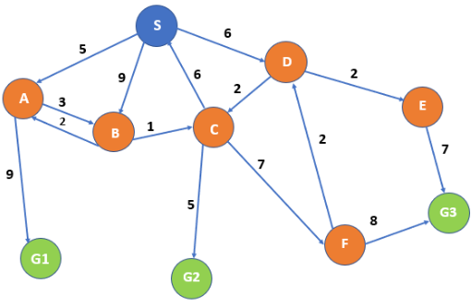
In-class Example: Uniform Cost Search

Slide 35
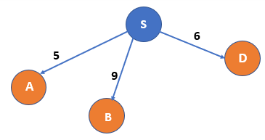
Uniform Cost Search example

Slide 36
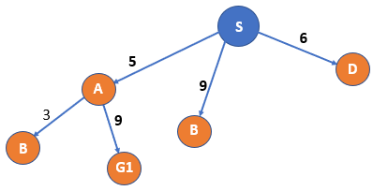
Uniform Cost Search example

Slide 37
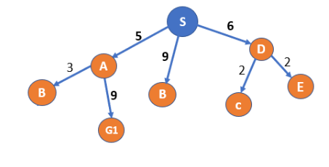
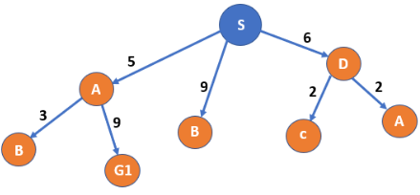
Uniform Cost Search example

Slide 38
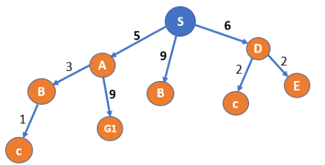
Uniform Cost Search example

Slide 39
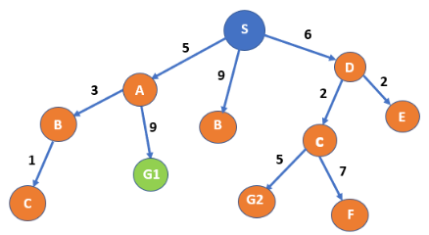
Uniform Cost Search example

Slide 40
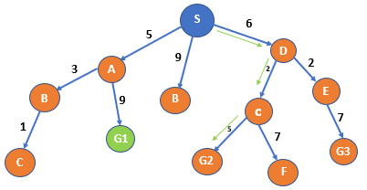
Uniform Cost Search example

Slide 41
Depth-limited search
= depth-first search with depth limit l, i.e., nodes at depth l have no successors
Complete? No
Time? O(b^{l})
Space? O(bl)
Optimal? No

Slide 42
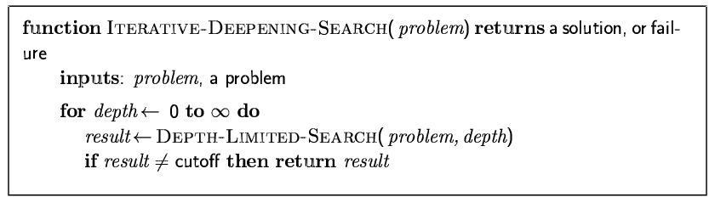
Iterative deepening search
= depth-limited search on repeat!
Limit l is increased at each iteration until goal is found

Slide 43
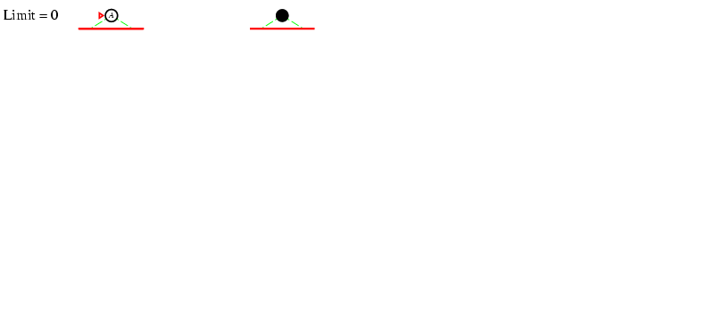
Iterative deepening search l =0

Slide 44
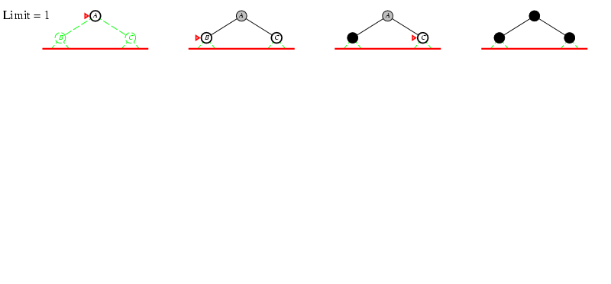
Iterative deepening search l =1

Slide 45
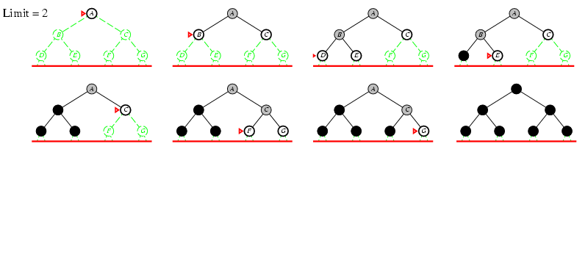
Iterative deepening search l =2

Slide 46
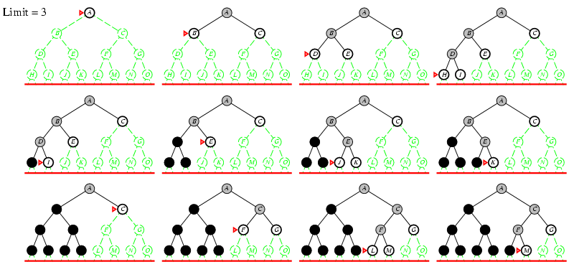
Iterative deepening search l =3

Slide 47
Properties of iterative deepening search
Complete? Yes
Time? (d+1)b⁰ + d b¹ + (d-1)b² + … + b^{d} = O(b^{d})
Space? O(bd)
Optimal? Yes, if step cost = 1

Slide 48
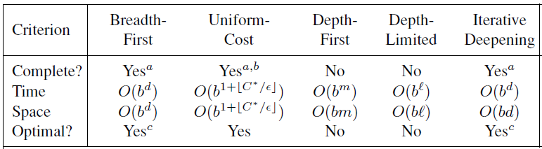
Summary of algorithms

